Slide 1
Capstone Project Interim Presentation
Group 14
Mentor: Mr. Mohit Sahu
Team Members: Ashwin M
Arun V
Shariqha Fathima Z
Aakash Russell
Aniket Anil Dhakate
Udhaya Kumar M

Slide 2

Flight Price Prediction for Users by Machine Learning Techniques

Slide 3
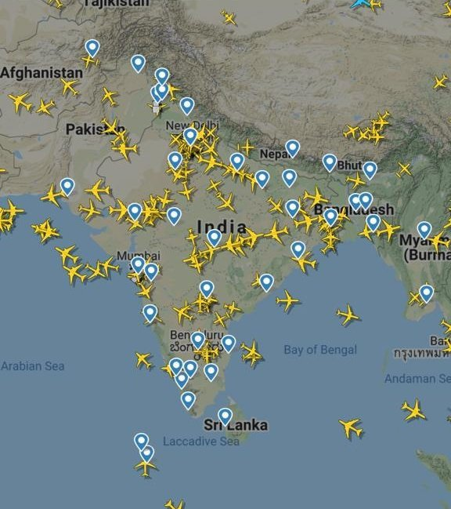



Technology and Business Objective:
Airline companies use complex algorithms to predict flight prices.
These methods followed by airline companies are difficult to maintain and change dynamically due to different conditions.
We can use this model to help the business to offer flight tickets at affordable price thereby increasing the customer satisfaction
And also help customers predict the future flight prices and plan their journey accordingly.

Slide 4


Why is it important problem?
To identify the factors affecting the price of the flight ticket
To help the customers to book flight tickets when maximum discounts are available
To find the optimum time to book flight ticket at a cheaper price.
Value Additions Planned..
Alert message pop-ups

Slide 5

Suggested Solution, Dataset and EDA

Slide 6

Suggested Solution:
Determine which factors have the greatest impact on price by analyzing the trends and graphs
Training the algorithm so that it can distinguish and predict Expensive and Cheap tickets
Testing the algorithm to predict the prices of future tickets
But First, Dataset!
3 lakh records and 11 columns
6 Airlines, 6 Cities, 6 Arrival Times and 6 Departure Times
3 types of number of stops, 2 types of seats,
Duration of 1561 flights and days left between booking and flying

Slide 7
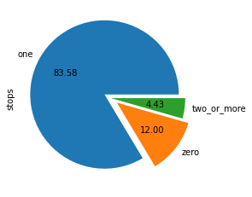
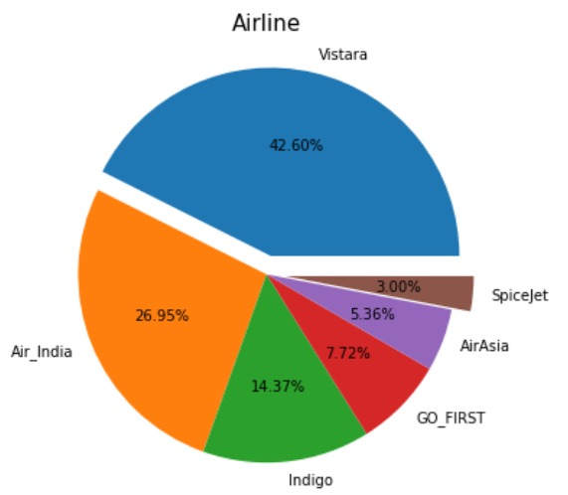
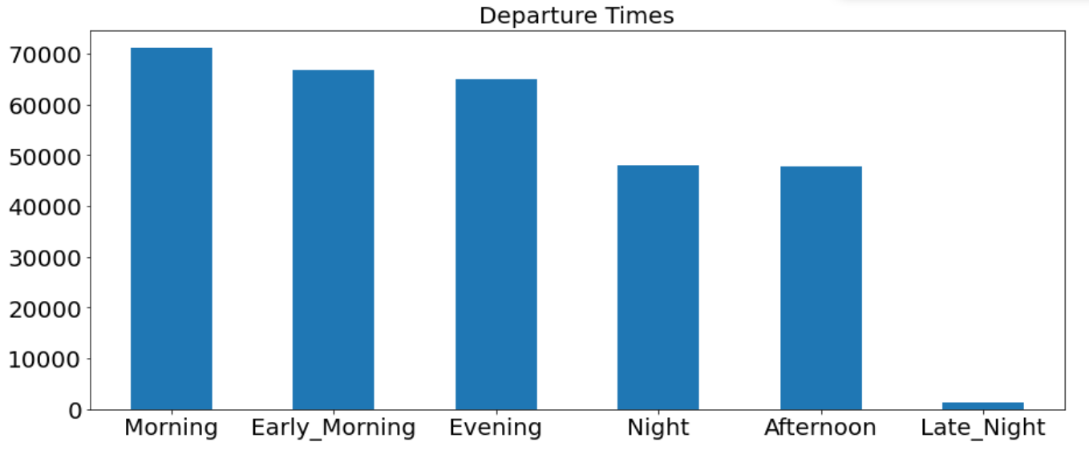
Exploratory Data Analysis
Most flights taken during Mornings.
Least flights taken during Late Nights.
Flights with one stop have flown the most.
Flights with two or more stops have flown the least.
Most flown- Vistara Airlines (42.60%)
Least flown-Spicejet Airlines (3.00%)

Slide 8
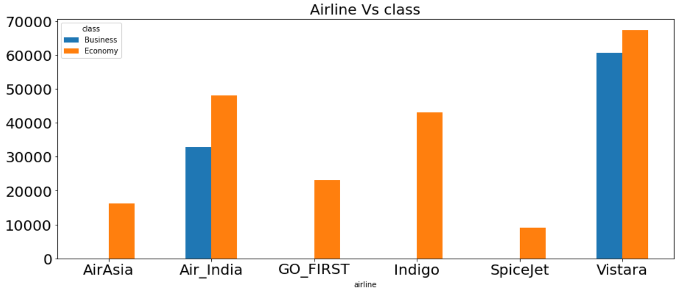
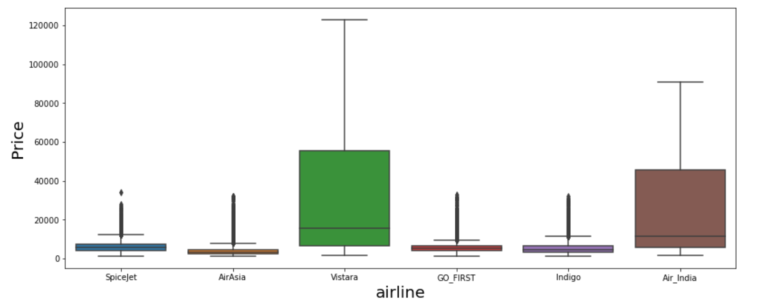
Exploratory Data Analysis
Most Passengers fly Economy.
Most people prefer Vistara and Air India for Business class seats.
Vistara and Air India prices are high compared to other airlines
This could be due to Business class passengers

Slide 9
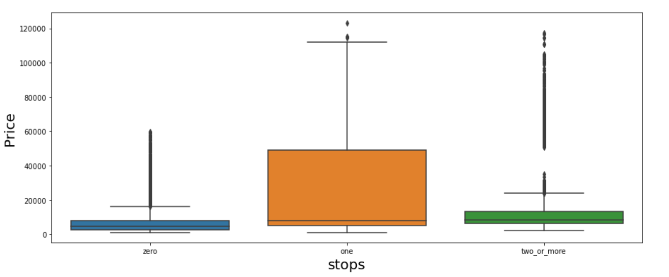
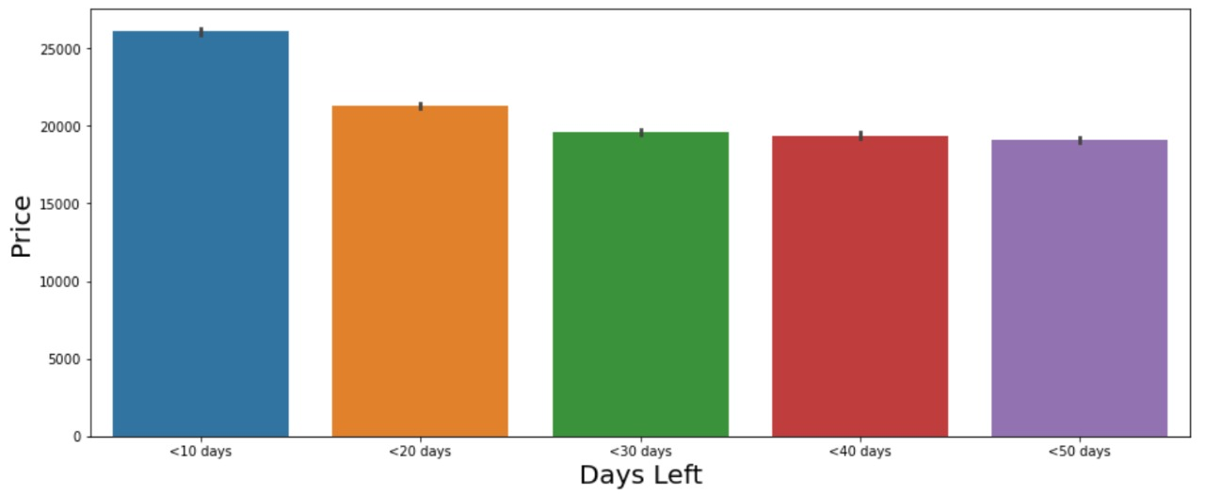
Exploratory Data Analysis
One stop tickets are priced highest as most prefer one stops rather than zero and two or more stops
Tickets booked less than 10 days are priced higher
Tickets booked less than 50 days before the flight are priced lower

Slide 10
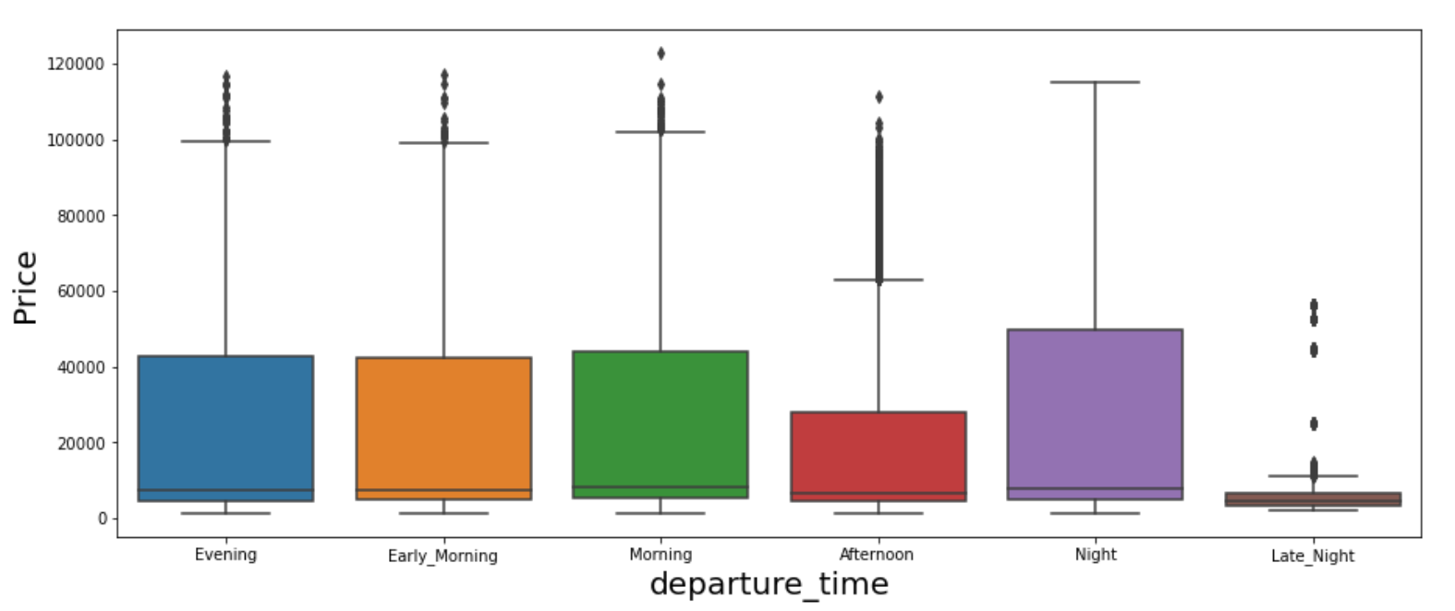
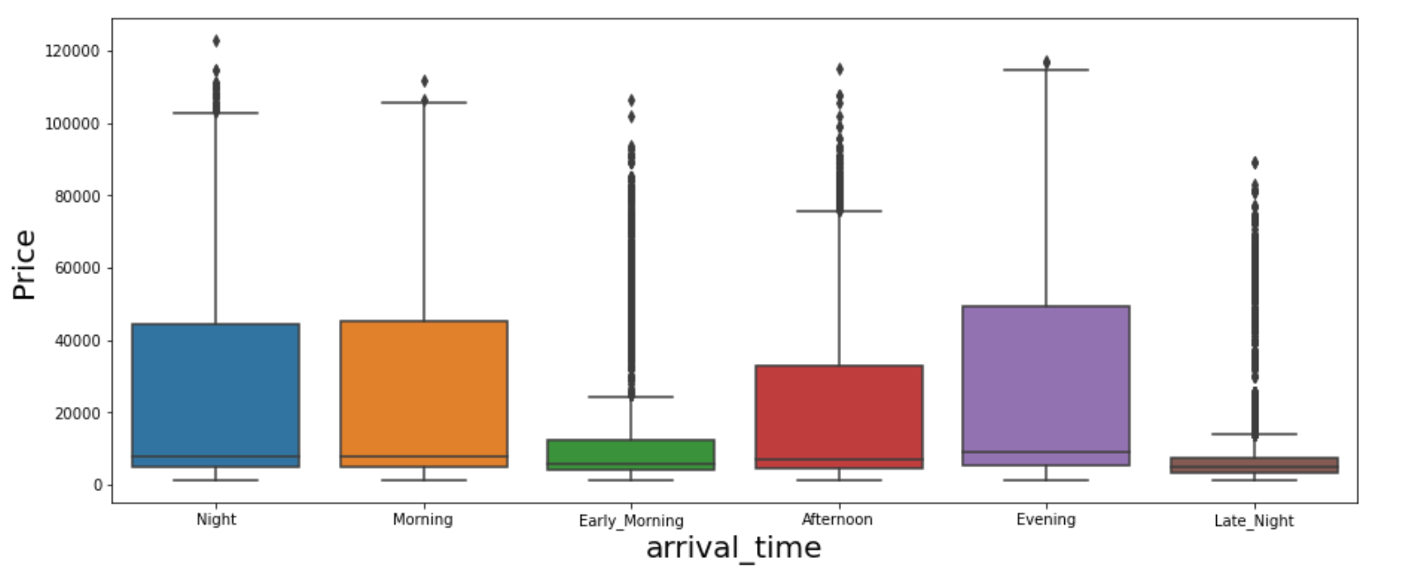
Exploratory Data Analysis
Ticket price for Departure times at Late nights are priced the lowest
Ticket price for Arrival times at Late nights and early mornings are priced the lowest

Slide 11
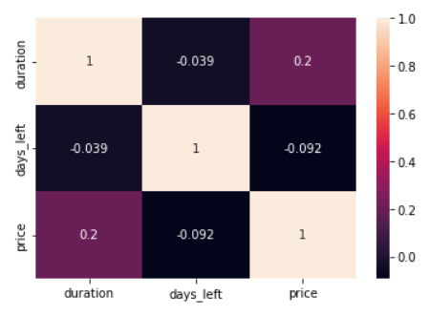
Challenges Expected/Addressed
Challenges Addressed
To find correlation between target and Independent variables through Feature Engineering
Feature Engineering and transformation of the predictor variable like Flights with other numerical predictors, This helps in finding correlation with our target
The better features we use, the better our model will perform.

Slide 12
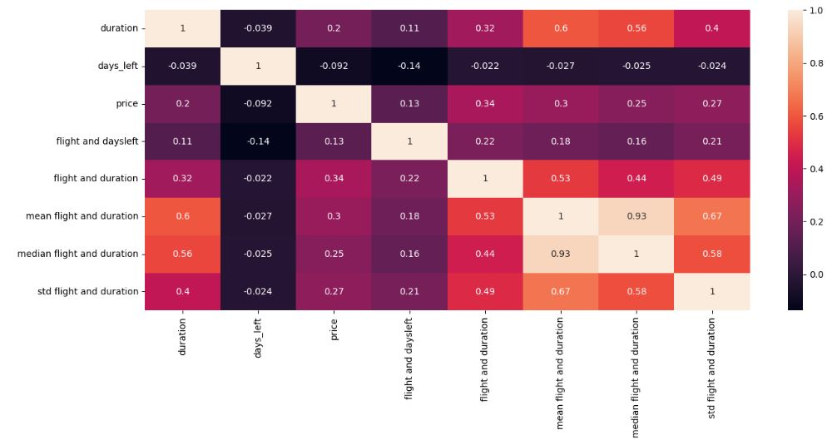
Challenges Expected/Addressed
Challenges Expected Moving Forward
Overfitting of Model due to less number of numerical features

Slide 13

Algorithms, Solution and Conclusions

Slide 14
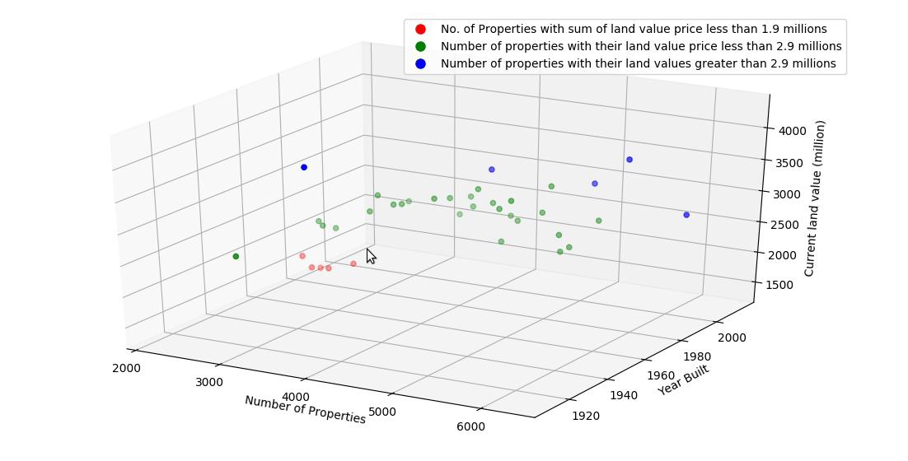
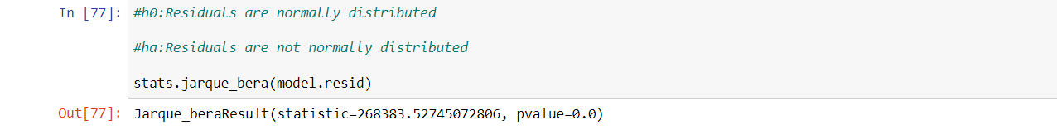
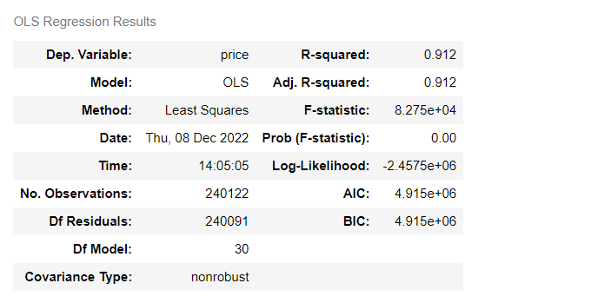
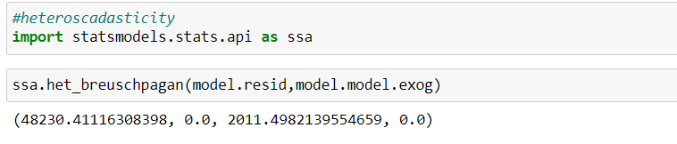
Algorithms considered:
Statistical Model for Linear Regression:
Ordinary Least Squares was used to create a statistical model for this data.
The assumptions Heteroscedasticity and Normality were not satisfied. Therefore a base model on the next best, Decision Tree Regressor was built.

Slide 15
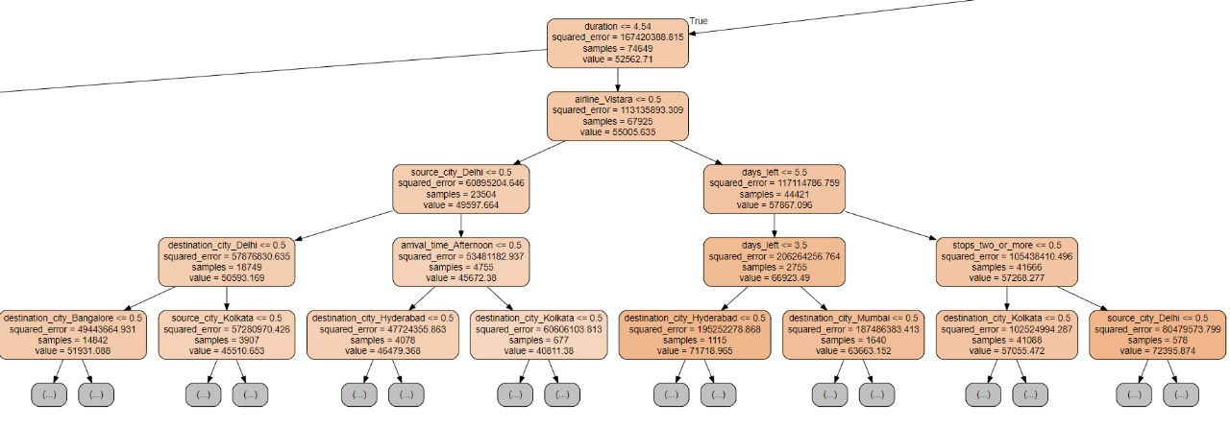
Algorithms considered:
Base Model: Decision Tree Regressor:
Decision Tree Model was built as a base model and evaluated with performance metrics
Stats model- Linear Regression- assumptions failed
Decsision tree regressor- base model
Dt- pros and cons
Solution architecture
Results and future followups

Slide 16
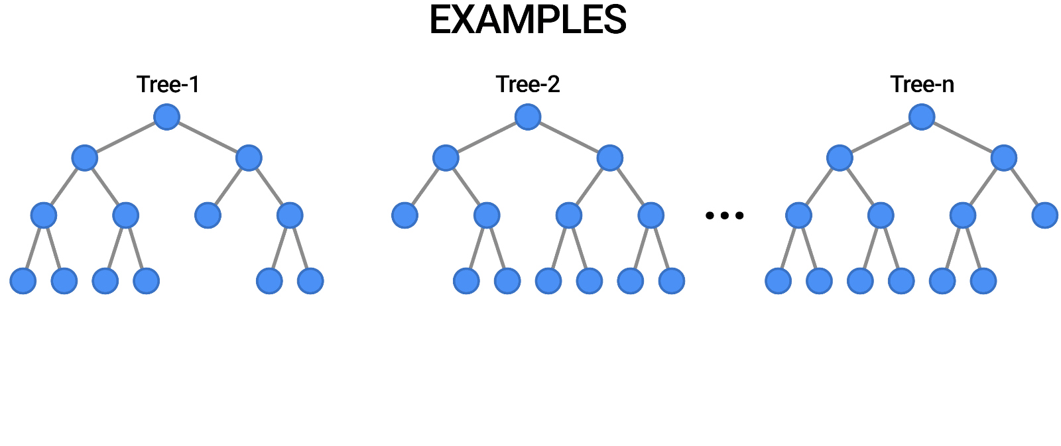
Decision Tree:
Pros and Cons of a Decision Tree Regressor
Pros:
1.It is easy to interpret, understand, and visualize. 2. data preparation during pre-processing requires less effort and does not require normalization of data 3. quickest ways to identify relationships between variables and the most significant variable.
Cons:
1. Overfitting is one of the practical difficulties for decision tree models. But this issue can be resolved by setting constraints on the model parameters. 2. Calculations involved can also become complex compared to other algorithms, and it takes a longer time to train the model. 3. It is also relatively expensive as the amount of time taken and the complexity levels are greater

Slide 17
Results From Decision Tree Regressor
To evaluate the model, the metrics like R2 score, Mean Squared Error are used. Applying the decision tree regressor on train and test data we get the following results.
 | Before Hyper Parameter Tuning |  | After Hyper Parameter Tuning
Metric | Train | Test | Train | Test
R2 score | 0.99 | 0.98 | 0.96 | 0.96
Root Mean Squared Error | 218.5 | 2948.4 | 4144.94 | 4169.95
Mean Absolute Error | 10.61 | 891.29 | 2286.28 | 2300.57
Mean Absolute Percentage Error | 0 | 0.058 | 0.16 | 0.16
The scores of the performance metrics shows that the model is overfitting.
The model is high on variance so we did hyper parameter tuning techniques like pruning with max depth = 10, min sample leaf = 1, min sample split = 4.
The results show an increase in error but consistency between train and test set, this shows high bias and low variance
We will build advance models to counter the bias using Ensemble techniques like boosting to improve our RMSE

Slide 18
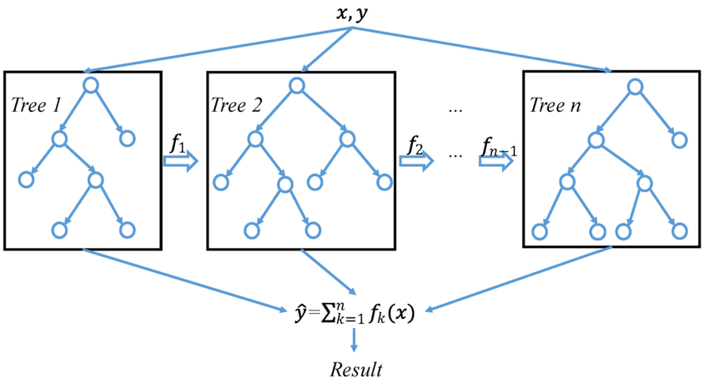
Algorithms considered:
Advanced Model: XGBoost Regressor Model
XGBoost Model was built as an advanced model and evaluated with performance metrics
Pros:
1. Less feature engineering required (No need for scaling, normalizing data, can also handle missing values well).
2. Good model performance. 3. Less prone to overfitting.
Cons:
1. Difficult interpretation , visualization tough.
2. Overfitting possible if parameters not tuned properly. 3. Harder to tune as there are too many hyperparameters.

Slide 19
Results From XGBoost Regressor
To evaluate the model, the metrics like R2 score, Mean Squared Error are used. Applying the XGBoost regressor on train and test data we get the following results.
 | Before Hyper Parameter Tuning |  | After Hyper Parameter Tuning
Metric | Train | Test | Train | Test
R2 score | 0.9834 | 0.9847 | 0.994 | 0.990
Root Mean Squared Error | 2797.15 | 2920.05 | 1731.54 | 2255.07
Mean Absolute Error | 1583.76 | 1632.55 | 945 | 1163
Mean Absolute Percentage Error | 0.129 | 0.132 | 0.08 | 0.09
From the above results, we can infer that the RMSE has reduced while maintaining the consistency between train and test sets
This is because in Boosting techniques, the wrongly predicted points are boosted in weightage in order to get predicted accurately in the subsequent weak learners.

Slide 20
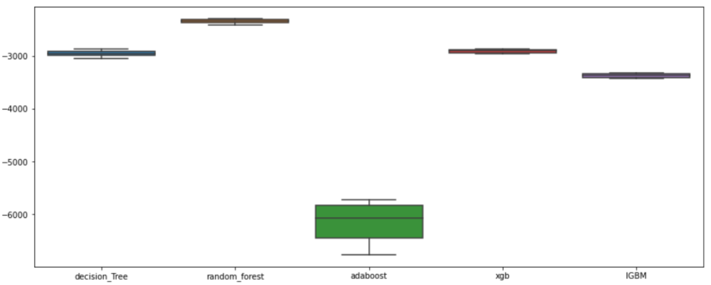
Advanced Models
The high variance resulting from Decision Tree regressor were countered using advanced models like AdaBoost, LGBM, XGB out of which LGBM and XGB gave the best results

Slide 21
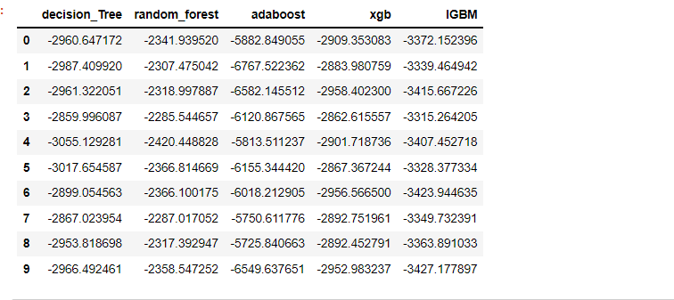
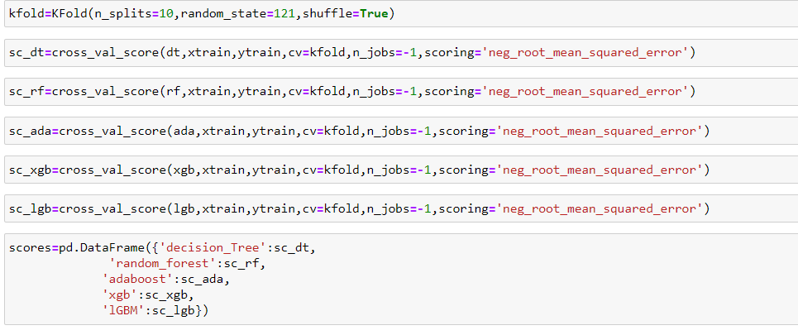
Cross Validation Scores of All Models (RMSE) :
The XGB Regressor is more reliable than the LGBM Regressor because the RMSE score of test data is significantly less.

Slide 22
Future Scope for Improvement:
The Seasonality in flight ticket prices ie., adding travel dates data to see how the effects of holidays and weekends affect ticket price.
To try and analyze passenger details to see whether they travel for business or leisure and their tolerance levels to changes in flight price.
To scrape data from other ticketing websites for domestic air travel in India like clear trip, make my trip, etc to see how the model works on their data and further tune the model.

Slide 23
Conclusions
A proper implementation of this project can result in saving money of inexperienced people by providing them the information related to trends that flight prices follow and also give them a predicted value of the price which they use to decide whether to book ticket now or later.
In conclusion, this type of service can be implemented with good accuracy of prediction. As the predicted value is not fully accurate there is a huge scope for improvement of these kind of service.

Slide 24

Thank you!

